Slide 1
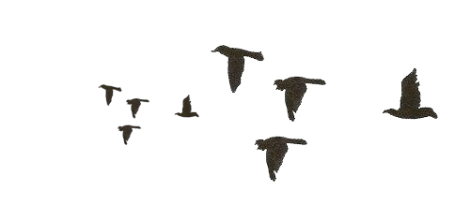

Slide 4
THE END

